Slide 1
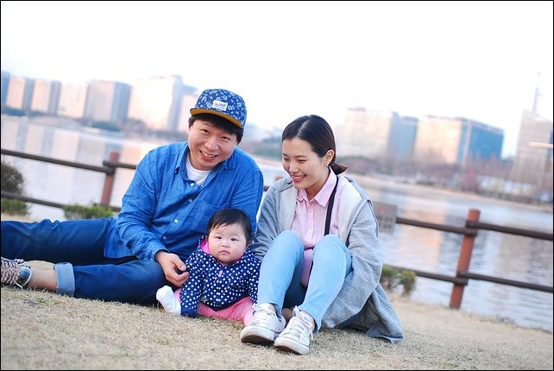

The Developing Parent
[Professor Name]
[Class and Section Number]
Notes:
Classroom Recommendations: This PowerPoint is presented in one 90-minute class but could also be taught in a two 50-60-minute classes. If teaching it in two classes, we recommend assigning the last assignment “Exploring Parenting Advice” to be done at home rather than during class. Please also refer to the Noba Instructor Manual that accompanies this outline.
Overview: This module focuses on parenthood as a developmental task of adulthood. Parents take on new roles as their children develop, transforming their identity as a parent as the developmental demands of their children change. The main influences on parenting, parent characteristics, child characteristics, and contextual factors, are described.
Special Instructions: Begin the class period by asking students a series of multiple choice questions about changes in parenthood over recent years. Cover the answers to each question and present them with interesting data from the Pew Research Center. Next, allow student to work in groups to cover the six stages of parent development. In this activity they will complete an advanced organizer to better remember the information. Using direct instruction, describe to the students the influence of parent and child characteristics on parenting behavior. A temperament questionnaire activity is then used to further explore how child characteristics impact parent behavior. Contextual and sociocultural influences are then covered using direct instruction. An assignment is given to the students to explore parenting advice on the Internet that has them reflect on the advice using the information from the module. The module content is then concluded and a classroom assessment technique, the minute paper, is utilized to end the lesson.
Technical Note: These slides may contain simple click animation so that you can focus students’ attention on a particular question, a selection of text, or an image and not have them be distracted by reading ahead. You can either preview the sequence of animation by going through the slides in slideshow view, visiting the animations tab, or reviewing the slide notes. In the notes you will see a cue - (Click) – that corresponds to each animation.
You may also find hyperlinks to outside videos at various places in the slides. These hyperlinks are embedded in text and indicated by color and in the notes section.

Slide 2
Learning Objectives
Identify and describe the stages of parenthood.
Identify and describe the influences on parenting.
Notes:
Purpose: This slide outlines the learning objectives of the module.

Slide 3
Overview
Introduction
Changes in Parenthood
The Six Stages of Parent Development
Influences on Parenting
Conclusion
Notes:
Purpose: The purpose of this slide is to provide students with an overview of the material that will be covered during the lecture

Slide 4
Warm up Activity Changes in Parenthood
What statement is true regarding paid work outside of the house?
Mothers and fathers are now spending equal time doing paid work.
Fathers spend more time then mothers doing paid work.
Mothers spend more time then fathers doing paid work.
There has been no change over time in the amount of paid work mothers or fathers have been doing.
Notes:
Purpose: This slide outlines a warm-up activity. This activity is completed during class and works as a great warm-up to introduce the module content. For this activity students will answer a series of questions and see data about the ways that parenting is changing over time in the US. This activity is described in the IM under ‘Activities/Demonstrations.’
Notes:
Psychologists have worked to understand why parents behave the way they do. While much is known about how parents impact children, less is understood about how parents develop and the impact of children on parents. Parenthood is a normative developmental task in adulthood; and people have children for emotional, economic, utilitarian, and social-normative reasons.
Directions:
Have students pull out a pen and paper to record answers to the quiz questions. Tell students the questions are not graded but are intended to get them thinking about current trends.
Using the PowerPoint slides provided, have students answer the quiz questions. The questions can also be found on the handout in Appendix A that could be given out and completed prior to starting class. There are 4 questions total, each accompanied by a slide that has a graph depicting the results.
After each question is asked cover the correct answer and show the students the corresponding data or source for the answer. Allow students to discuss with one another if they were correct in their responses. Allow them also to ask questions or to discuss surprises or confirmed expectations about the changes in parenthood.
(Click): Question 1
(Click): Answer → B “Dads are doing more housework and child care; moms more paid work outside the home. Neither has overtaken the other in their “traditional” realms, but their roles are converging.”
Research Statistic Source: Pew Research Center. (2013). Modern Parenthood. Retrieved from
http://www.pewsocialtrends.org/2013/03/14/modern-parenthood-roles-of-moms-and-dads-converge-as-they-balance-work-and-family/

Slide 5
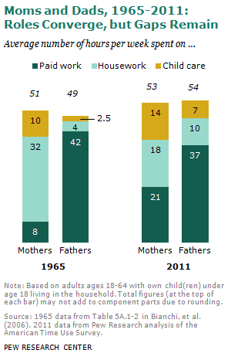
Notes:
Purpose: This slide shows the graph that explains the answer to question 1 on slide 4.
Notes: Describe to students the changes seen in paid work, housework and childcare from 1965 to 2011.
Graph Source: Pew Research Center. (2013). Modern Parenthood. Retrieved from
http://www.pewsocialtrends.org/2013/03/14/modern-parenthood-roles-of-moms-and-dads-converge-as-they-balance-work-and-family/

Slide 6
Warm up Activity Changes in Parenthood
How has first time mothers’ age changed over time?
There has been no change
Mothers are getting younger
Mothers are getting older
Notes:
Purpose: This slide continues the warm-up Changes in Parenthood quiz. activity.
(Click): Question 2: According to the Pew Research Center, how has first time mothers age changed over time?
(Click): Answer - C → “The demography of motherhood in the United States has shifted strikingly in the past two decades. Compared with mothers of newborns in 1990, today’s mothers of newborns are older and better educated. They are less likely to be white and less likely to be married”
Research Statistic Source: Pew Research Center. (2010). The New Demography of American Motherhood. Retrieved from http://www.pewsocialtrends.org/2010/05/06/the-new-demography-of-american-motherhood/

Slide 7
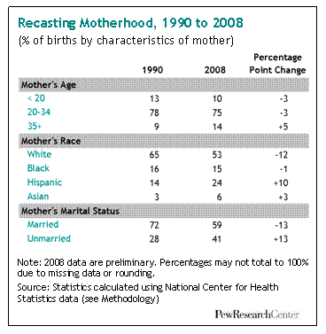
Notes:
Purpose: This slide shows the graph that explains the answer to question 2 on slide 6.
Notes: Describe to students the changes seen in mothers age, race and marital status.
Graph Source: Pew Research Center. (2010). The New Demography of American Motherhood. Retrieved from
http://www.pewsocialtrends.org/2010/05/06/the-new-demography-of-american-motherhood/

Slide 8
Warm up Activity Changes in Parenthood
“7% of U.S. fathers with children in their household do not work outside the home—that’s roughly 2 million dads.” What is the top reason more dads are staying home than in the past?
Cant find work
Caring for family
Ill or disabled
In school
Notes:
Purpose: This slide continues the warm-up Changes in Parenthood quiz. activity.
(Click): Question 3: According to the Pew Research Center “7% of U.S. fathers with children in their household do not work outside the home – that’s roughly 2 million dads”. What is the top reason more dads are staying home then in the past?
(Click): Answer B → “Much of the increase in stay-at-home fathers can be attributed to more fathers caring for their family. In 2012, 21% of these dads said their main reason for staying home was caring for home or family—four times the share in 1989. Then, more than half (56%) reported being home due to illness or disability. In 2012, only 35% cited illness or disability as their primary reason.”
Research Statistic Source: Pew Research Center. (2015). 5 facts about today’s fathers. Retrieved from
http://www.pewresearch.org/fact-tank/2015/06/18/5-facts-about-todays-fathers/

Slide 9
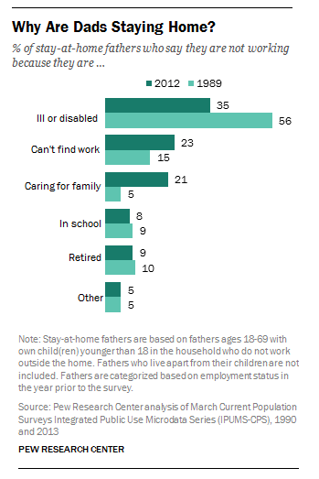
Notes:
Purpose: This slide shows the graph that explains the answer to question 3 on slide 8.
Notes: Describe to students the changes seen in paid work, housework and childcare from 1965 to 2011.
Graph Source: Pew Research Center. (2015). 5 facts about today’s fathers. Retrieved from
http://www.pewresearch.org/fact-tank/2015/06/18/5-facts-about-todays-fathers/

Slide 10
Warm up Activity Changes in Parenthood
What statement is true regarding how today’s mothers and fathers rate themselves?
More mothers think they are doing an excellent or very good job compared to fathers.
More fathers think they are doing an excellent or very good job compared to mothers.
Mothers and fathers think they are doing an equal job.
Less working mothers think they are doing an excellent or very good job compared to non-working mothers.
Notes:
Purpose: This slide continues the warm-up Changes in Parenthood quiz. activity.
(Click): Question 4 – According the Pew Research Center, what statement is true regarding how today’s mothers and fathers rate themselves?
(Click): Answer A → “Mothers give themselves somewhat higher ratings than do fathers: 73% of mothers say they are doing an excellent or very good job as a parent, compared with 64% of fathers.”
Research Statistic Source: Pew Research Center. (2013). Modern Parenthood. Retrieved from http://www.pewsocialtrends.org/2013/03/14/modern-parenthood-roles-of-moms-and-dads-converge-as-they-balance-work-and-family/

Slide 11
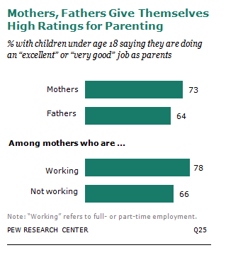
Notes:
Purpose: This slide shows the graph that explains the answer to question 3 on slide 8.
Notes:. Describe the statistics presented.
Conclusion: Across the world, including the US, parenthood is undergoing changes. Children are less likely to live with both parents, parents are having few children overall and are older when they have children, and many children are being born outside of a parent marriage.
Graph Source: Pew Research Center. (2013). Modern Parenthood. Retrieved from http://www.pewsocialtrends.org/2013/03/14/modern-parenthood-roles-of-moms-and-dads-converge-as-they-balance-work-and-family/

Slide 12
Overview
Introduction
The Six Stages of Parent Development
Image making
Nurturing
Authority
Interpretive
Interdependent
Departure
Influences on Parenting
Conclusion
Notes:
Purpose: The purpose of this slide is to provide students with an overview of the material that will be covered during the lecture

Slide 13
The Six Stages of Parent Development
1. The Image Making Stage
2. The Nurturing Stage
3. The Authority Stage
4. The Interpretive Stage
5. The Interdependent Stage
6. The Departure Stage
Notes:
Purpose: This slide is meant introduce the 6 stages of parent development.
Notes: Galinsky (1987) outlined the stages that parents go through as they develop new skills and abilities based on their child’s growth. However, it should be noted that currently these theoretical stages are not yet generalizable to parents of different races, ages, and religions, nor is there empirical data on the factors that influence individual differences in these stages.
6 Stages Group Activity: To cover the 6 stages of parent development students work in teams to fill out information on an advanced organizer. Groups work alone and then share their ideas with the class.
Directions:
Introduce the 6 stages of parent development using this PowerPoint slide.
Divide students into teams. You can have 6 teams of 3-4, or 12 teams of 2-3, or more depending on your class size. Assign each of the groups with a stage.
Students work to complete all the information requested on the advanced organizer (see Instructor Manual for the advanced organizer template and Appendix B in these slides).
Have one group from each stage share their work with the class. You can ask students to share their aspect of the advanced organizer using a document camera, by writing the information on the board, or copying it and emailing it to students later on. They can also take notes as the group shares just make sure students are clear and go slow enough so that everyone can obtain the information needed.
Notes:
The Image Making Stage: As parents plan for a child during pregnancy they imagine their future role as parents, reflect on their experiences with their parents and develop ideas about what type of parent they want to be.
The Nurturing Stage: During infancy parents work to develop an attachment to their new baby. For some this is fast while for others it takes time. Adult relationships shift (romantic and family). Parents identity is reshaped as parenting responsibilities are the most demanding during infancy.
The Authority Stage: From 2 to 4/5-years old parents are establishing rules and deciding on consequences for their child’s behavior.
The Interpretive Stage: School age children (kindergarten though adolescents) require parents to help interpret their experiences. Parents are learning when to step in and when to allow children autonomy as they explore interests, relationships with peers, and learn behaviors and values their parents deem appropriate.
The Interdependent Stage: Teenagers and parents need to work together in this stage to make decisions in such a way that youth practice autonomy but parents still have influence and authority.
The Departure Stage: Parents are evaluating their success and failures and preparing for their child’s departure into adulthood. Parenting adult children is much different as it becomes a less central role.
Reference:
Galinsky, E. (1987). The Six Stages of Parenthood. Cambridge, MA: Perseus Books.

Slide 14
Overview
Introduction
The Six Stages of Parent Development
Influences on Parenting
Parent characteristics
Child characteristics
Contextual Factors and Sociocultural Characteristics
Conclusion
Notes:
Purpose: The purpose of this slide is to provide students with an overview of the material that will be covered during the lecture

Slide 15
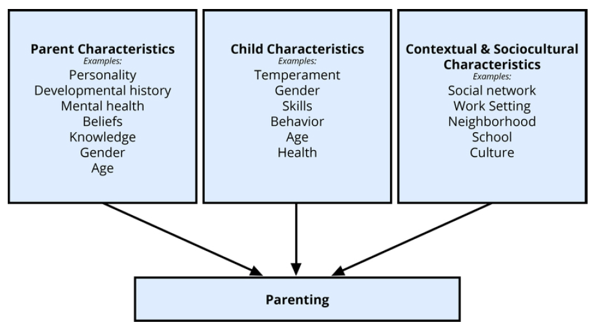
Influences on Parenting
Notes:
Purpose:
The purpose of this slide is to cover influences on parenting.
Notes:
(Click): the proposed influences on parent behavior include the parent’s characteristics, the child’s characteristics, as well as contextual and sociocultural characteristics.
(Click): Parent characteristics: Characteristics including parent age, gender, personality, developmental history, and health all affect their behaviors. Parents who are agreeable, outgoing, conscientious, and are less anxious and negative, are warmer and provide more structure and support their children’s autonomy. Parent’s experiences as children also have an effect. Parents learn positive and negative behaviors from their own parents, however, some will change their parenting methods if they were dissatisfied with their own parents approach.

Slide 16
Influences on Parenting
Notes:
Purpose:
The purpose of this slide is to cover influences on parenting.
(Click): Child characteristics: Child characteristics, such as gender, birth order, temperament, and health status affect parents’ behavior. Temperament is particularly influential as difficult children decrease parent confidence, increase punitive approaches, and decrease satisfaction in marriages, work, and family roles. Gender is also particularly influential as parents treat and talk to boys and girls differently.
Note: The Contextual and Sociocultural Characteristics content will continue on slide 20, following a brief activity

Slide 17
Temperament Questionnaire
Complete the questions honestly
Score your responses:
Sum items 2, 4, 5, 8, 10, 11 to obtain an approach temperament score
Sum items 1, 3, 6, 7, 9, 12 to obtain an avoidance temperament score
Notes:
Instructor Note: please click on the following link to view the Temperament Questionnaire:
The PDF containing this questionnaire can be found in Appendix A of the article at the following link: https://www.researchgate.net/profile/Todd_Thrash/publication/44697459_Approach_and_avoidance_temperament_as_basic_dimensions_of_personality/links/540f1d2b0cf2f2b29a3dd390.pdf
Purpose: This slide is for the Temperament Questionnaire activity. Have the students complete the Approach & Avoidance Temperament Questionnaire (Elliot & Thrash, 2010). Students will reflect on their answers by thinking about the influence their temperament might have had on their parents and their own parenting behavior.
(Click): Directions: ask the students to complete the questions honestly.
(Click): Have students score their responses.
PsycTESTS Citation:
Elliot, A. J., & Thrash, T. M. (2010). Approach-Avoidance Temperament Questionnaire [Database record]. Retrieved from PsycTESTS. doi: http://dx.doi.org/10.1037/t19974-000
Permissions: Test content may be reproduced and used for non-commercial research and educational purposes without seeking written permission. Distribution must be controlled, meaning only to the participants engaged in the research or enrolled in the educational activity. Any other type of reproduction or distribution of test content is not authorized without written permission from the author and publisher. Always include a credit line that contains the source citation and copyright owner when writing about or using any test.

Slide 18

Temperament Questionnaire
Temperament
Reactivity
Self-Regulation
Approach & Avoidance
Responsiveness
Notes:
Purpose: This slide is for the Temperament Questionnaire activity.
Notes: Define temperament and the approach/avoidance dimension
(Click): Temperament can be understood as Stable behavioral & emotional reactions that appear early & are influenced in part by genetics. It is often conceptualized as Reactivity (quickness & intensity of emotional arousal, attention and motor action) and Self Regulation (strategies to modify the reaction).
(Click): Approach and avoidance are measured in a person’s temperament as one dimension that characterizes their responses to a new object, food, person or situation. Research shows that children’s temperament consistently predicts their cognitive and social functions.

Slide 19
Temperament Questionnaire
How would a child with an approach temperament affect their parents behavior?
How would a child with an avoidance temperament affect their parents behavior?
How might these traits in you affect how you parent a child?
Notes:
Purpose: This slide is for the Temperament Questionnaire activity.
Notes: Pose the two discussion questions on the PowerPoint slide. Allow students time to talk with one another. Lead a larger class discussion to sum up the activity.
(Click): Show discussion questions
How would a child with an approach temperament affect their parents behavior?
How would a child with an avoidance temperament affect their parents behavior
How might these traits in you affect how you parent a child?
Notes: Responses will vary. Pulling information from the module will help to summarize the classes contributions. A child with an easy temperament (approach) may enable parents to feel more effective, as they are easily able to soothe the child and elicit smiling and cooing. A child with a difficult temperament (avoidance) may get fewer positive reactions from his or her parents and may result in parents feeling less effective in the parenting role.

Slide 20
Influences on Parenting
Notes:
Purpose: The purpose of this slide is to cover influences on parenting.
(Click): Contextual Factors and Sociocultural Characteristics: Socioeconomic hardship can negatively influence parenting skills and behaviors. Culture determines what goals are important for children. Parenting skills are thus culturally specific. Neighborhoods, schools and social networks are also contextual factors that play a role.

Slide 21
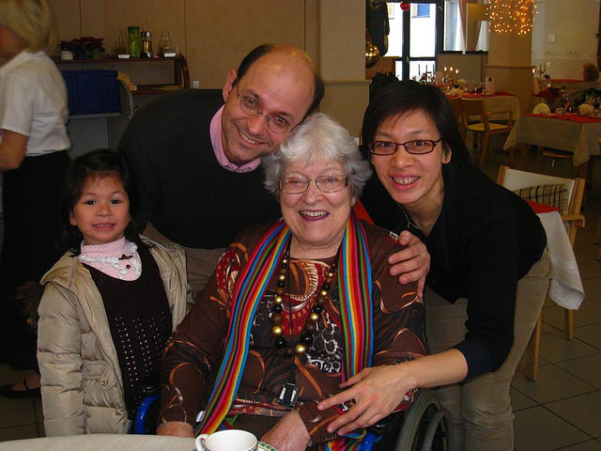
Exploring Parenting Advice
Initial search →
best parenting advice
Focused search → parenting topic of your choice
Find a reliable source
Answer the questions on your handout
Notes:
Purpose: This slide is for the Exploring Parenting Advice assignment.
Notes: Parenting advice is one of the biggest industries related to child development. There are books, workshops, DVD’s, and products geared toward parents and their behavior. This activity is designed to show you the vast market that exists in regard to parenting advice. It is also intended to allow you a chance to apply what you have learned in the Developing Parent Module to understand some of the advice that is out there, and to use a critical eye when being a consumer of such information.
(Click): Initial search → best parenting advice
Using the Internet do an initial search looking for “best parenting advice.” Skim through some of the sources that turn up.
(Click): Focused search → parenting topic of your choice
After initial browsing narrow you search. You can look up advice about sleeping, behavior problems, diet, or any other parenting related behavior that you are interested in.
(Click): Find a reliable source
Once you have settled on a topic, select a source of parenting advice that is reputable.
(Click): Answer the questions on your handout
Answer the questions on the handout.

Slide 22
Overview
Introduction
The Six Stages of Parent Development
Influences on Parenting
Conclusion
Notes:
Purpose: The purpose of this slide is to provide students with an overview of the material that will be covered during the lecture

Slide 23
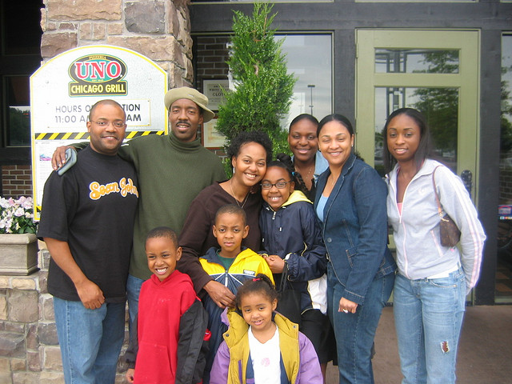
Conclusion
Bidirectional relationship
Behavior changes over time
Notes:
Purpose: The purpose this slide is to conclude the content.
(Click): Many factors influence parent’s behaviors including a bidirectional relationship between parents and children and the context in which they live. Parents behavior will change over time as they create new identities to face new challenges.
Note: If you would like additional prompts for this slide, please see the following excerpt from The Developing Parent Module:
“Parenting is bidirectional. Not only do parents affect their children, children influence their parents. Child characteristics, such as gender, birth order, temperament, and health status, affect parenting behaviors and roles. For example, an infant with an easy temperament may enable parents to feel more effective, as they are easily able to soothe the child and elicit smiling and cooing. On the other hand, a cranky or fussy infant elicits fewer positive reactions from his or her parents and may result in parents feeling less effective in the parenting role (Eisenberg et al., 2008). Over time, parents of more difficult children may become more punitive and less patient with their children (Clark, Kochanska, & Ready, 2000; Eisenberg et al., 1999; Kiff, Lengua, & Zalewski, 2011). Parents who have a fussy, difficult child are less satisfied with their marriages and have greater challenges in balancing work and family roles (Hyde, Else-Quest, & Goldsmith, 2004). Thus, child temperament is one of the child characteristics that influences how parents behave with their children.”
References:
Clark, L. A., Kochanska, G., & Ready, R. (2000). Mothers’ personality and its interaction with child temperament as predictors of parenting behavior. Journal of Personality and Social Psychology, 79, 274–285.
Eisenberg, N., Hofer, C., Spinrad, T., Gershoff, E., Valiente, C., Losoya, S. L., Zhou, Q., Cumberland, A., Liew, J., Reiser, M., & Maxon, E. (2008). Understanding parent-adolescent conflict discussions: Concurrent and across-time prediction from youths’ dispositions and parenting. Monographs of the Society for Research in Child Development, 73, (Serial No. 290, No. 2), 1-160.
Eisenberg, N., Fabes, R. A., Shepard, S. A., Guthrie, I.K., Murphy, B.C., & Reiser, M. (1999). Parental reactions to children’s negative emotions: Longitudinal relations to quality of children’s social functioning. Child Development, 70, 513-534.
Hyde, J. S., Else-Quest, N. M., & Goldsmith, H. H. (2004). Children’s temperament and behavior problems predict their employed mothers’ work functioning. Child Development, 75, 580–594.
Kiff, C. J., Lengua, L. J., & Zalewski, M. (2011). Nature and nurturing: Parenting in the context of child temperament. Clinical Child and Family Psychology Review, 14, 251–301. doi: 10.1007/s10567-011-0093-4

Slide 24

CAT: One-Minute Paper
The Minute Paper
What is the most important point you learned today?
What important question remains unanswered?
Notes:
Purpose: Use this CAT to conclude class and to obtain feedback from students about the content and the lesson.
Classroom Assessment Technique (CAT): One-Minute Paper
If you are presenting the information on one class day, you might end the material about here. End your class time with a one-minute paper.
The Minute Paper tests how students are gaining knowledge, or not. The instructor ends class by asking students to write a brief response to the following questions: “What was the most important thing you learned during this class?” and “What important question remains unanswered?”
Have students briefly answer these questions in writing and turn them in. After class, assess students’ responses. At the beginning of the next class, go over any misunderstandings or relevant questions.
Source: Angelo, T. A., & Cross, P. K. (1993). Classroom assessment techniques: A handbook for college teachers. San Francisco, CA: Jossey-Bass.
If you do not conclude with this Classroom Assessment Technique (CAT), it would helpful to use another CAT. It could be in the form of a:
Muddy point
One-minute paper
Background knowledge
What’s the Principle?
Defining features Matrix:
For more information on CATs click here: http://cft.vanderbilt.edu/guides-sub-pages/cats/

Slide 25
Appendix A
Changes in Parenthood Quiz
According to the Pew Research Center, what statement is true regarding paid work outside of the house?
Mothers and fathers are now spending equal time doing paid work.
Fathers spend more time then mothers doing paid work.
Mothers spend more time then fathers doing paid work.
There has been no change over time in the amount of paid work mothers or fathers have been doing.
According to the Pew Research Center, how has first time mothers age changed over time?
There has been no change
Mothers are getting younger
Mothers are getting older
According to the Pew Research Center, “7% of U.S. fathers with children in their household do not work outside the home—that’s roughly 2 million dads.” What is the top reason more dads staying home then in the past?
Can’t find work
Caring for family
Ill or disabled
In school
According to the Pew Research Center, what statement is true regarding how today’s mothers and fathers rate themselves?
More mothers think they are doing an excellent or very good job compared to fathers.
More fathers think they are doing an excellent or very good job compared to mothers.
Mothers and fathers think they are doing an equal job.
Less working mothers think they are doing an excellent or very good job compared to non-working mothers.
Notes:
Answer Key: For instructor use only
B → “Dads are doing more housework and child care; moms more paid work outside the home. Neither has overtaken the other in their “traditional” realms, but their roles are converging.”
http://www.pewsocialtrends.org/2013/03/14/modern-parenthood-roles-of-moms-and-dads-converge-as-they-balance-work-and-family/
C → “The demography of motherhood in the United States has shifted strikingly in the past two decades. Compared with mothers of newborns in 1990, today’s mothers of newborns are older and better educated. They are less likely to be white and less likely to be married”
http://www.pewsocialtrends.org/2010/05/06/the-new-demography-of-american-motherhood/
B → “Much of the increase in stay-at-home fathers can be attributed to more fathers caring for their family. In 2012, 21% of these dads said their main reason for staying home was caring for home or family—four times the share in 1989. Then, more than half (56%) reported being home due to illness or disability. In 2012, only 35% cited illness or disability as their primary reason.”
http://www.pewresearch.org/fact-tank/2015/06/18/5-facts-about-todays-fathers/
A → “Mothers give themselves somewhat higher ratings than do fathers: 73% of mothers say they are doing an excellent or very good job as a parent, compared with 64% of fathers.”
http://www.pewsocialtrends.org/2013/03/14/modern-parenthood-roles-of-moms-and-dads-converge-as-they-balance-work-and-family/

Slide 26
Appendix B
1. The Image Making Stage
How old is the child?
What is the main task or goal of parenthood?
What challenges exist for parents?
What parent characteristics influence parenthood here?
What child characteristics influence parenthood here?
What contextual factors influence parenthood here?
2. The Nurturing Stage
How old is the child?
What is the main task or goal of parenthood?
What challenges exist for parents?
What parent characteristics influence parenthood here?
What child characteristics influence parenthood here?
What contextual factors influence parenthood here?
3. The Authority Stage
How old is the child?
What is the main task or goal of parenthood?
What challenges exist for parents?
What parent characteristics influence parenthood here?
What child characteristics influence parenthood here?
What contextual factors influence parenthood here?
4. The Interpretive Stage
How old is the child?
What is the main task or goal of parenthood?
What challenges exist for parents?
What parent characteristics influence parenthood here?
What child characteristics influence parenthood here?
What contextual factors influence parenthood here?
5. The Interdependent Stage
How old is the child?
What is the main task or goal of parenthood?
What challenges exist for parents?
What parent characteristics influence parenthood here?
What child characteristics influence parenthood here?
What contextual factors influence parenthood here?
6. The Departure Stage
How old is the child?
What is the main task or goal of parenthood?
What challenges exist for parents?
What parent characteristics influence parenthood here?
What child characteristics influence parenthood here?
What contextual factors influence parenthood here?
Notes:
Information for student groups to complete
6 Stages Group Activity: Advanced organizers help students remember information. In this activity each student is given a blank advanced organizer to take notes on. Groups are created and assigned a stage to fill in on the advanced organizer. At the conclusion of the activity students share their stage with the rest of the class so that the advanced organizer can be completed in full.
Time: 25 minutes
Materials: 6 Stage advanced organizer, PowerPoint slides, module for student reference and the Internet for additional research if needed.
Directions:
Introduce the 6 stages of parent development using the PowerPoint slides.
Divide students into teams. You can have 6 teams of 3-4, or 12 teams of 2-3, or more depending on your class size. Assign each of the groups with a stage.
Student’s work to complete all the information requested on the advanced organizer, see Appendix B.
Have one group from each stage share their work with the class. You can ask students to share their aspect of the advanced organizer using a document camera, by writing the information on the board, or copying it and emailing it to students later on. They can also take notes as the group shares just make sure students are clear and go slow enough so that everyone can obtain the information needed.

Slide 27
Appendix B
Notes:
Blank advanced organizer to use as handout for groups doing the 6 Stages activity.
Click the icon to open and print if necessary.

Slide 28
Appendix C
Notes:
Temperament Questionnaire Handout
Click the icon to open and print if necessary.

Slide 29
Appendix D
Notes:
Exploring Parenting Advice Handout
Click the icon to open and print if necessary.

Slide 30
Photo Attribution
Slide 1 | Photo Credit: Family kim881231 https://pixabay.com/en/family-korean-baby-smile-parents-320659/ https://creativecommons.org/publicdomain/zero/1.0/deed.en
Slide 5 | Graph Source: Pew Research Center. (2013). Modern Parenthood. Retrieved from http://www.pewsocialtrends.org/2013/03/14/modern-parenthood-roles-of-moms-and-dads-converge-as-they-balance-work-and-family/
Slide 7 | Graph Source: Pew Research Center. (2010). The New Demography of American Motherhood. Retrieved from http://www.pewsocialtrends.org/2010/05/06/the-new-demography-of-american-motherhood/
Slide 9 | Graph Source: Pew Research Center. (2015). 5 facts about today’s fathers. Retrieved from http://www.pewresearch.org/fact-tank/2015/06/18/5-facts-about-todays-fathers/
Slide 11 | Graph Source: Pew Research Center. (2013). Modern Parenthood. Retrieved from http://www.pewsocialtrends.org/2013/03/14/modern-parenthood-roles-of-moms-and-dads-converge-as-they-balance-work-and-family/
Slide 18 | Photo Credit: 1o mês de uma vida de muito amor ♡ Ana Laura D F Hermann https://www.flickr.com/photos/46472677@N00/15432649458/ https://creativecommons.org/licenses/by-nc/2.0/
Slide 21 | Photo Credit: Jeanne Marie Rigopoulos Tasso and family 1 Ed https://www.flickr.com/photos/gooseotter/16000459562 https://creativecommons.org/licenses/by/2.0/
Slide 23 | Photo Credit: friends and family The Good Doctor https://www.flickr.com/photos/unbowed/13776402 https://creativecommons.org/licenses/by/2.0/
Slide 24 | Photo Credit: Photo Credit: Illustrated silhouette of a black cat nehtaeh79 http://www.freestockphotos.biz/stockphoto/16624 http://creativecommons.org/publicdomain/zero/1.0/
Notes:
Photo Attribution Slide

